Slide 1



Analyzing Environmental data
Sk Ayesha-24bq1a051y
P Sowmya-24bq1a54d1

Slide 2
CONTENTS
1.Abstract
2.Introduction
3.Problem Statement
4.Project Objectives
5.Dataset Overview
6.Data cleaning and preprocessing
7.Advantanges of project
8.Hardware and software requirements
9.Libraries used
10.Charts.
11.Conclusion

Slide 3


ABSTRACT
This project presents an analysis of Air Quality in India (2017–2022) using Python. Air pollution is a major problem that affects people's health and the environment. This project uses a dataset containing PM2.5 values collected from different locations in India. Using Pandas, NumPy, Matplotlib, and Seaborn, the dataset is loaded, cleaned, and analyzed. The analysis includes checking missing values, duplicate rows, data types, maximum and minimum PM2.5 values, and statistical summary. It also shows year-wise, month-wise, day-wise, and hour-wise PM2.5 trends. Different charts such as line charts, bar charts, scatter plots, histograms, box plots, and heatmaps are used to understand pollution patterns. Outlier detection, correlation analysis, and trend smoothing are also performed. The results help us understand PM2.5 pollution trends and show how data analysis can support better environmental awareness and decision-making.

Slide 4
Introduction
▶ What is Air Quality?
Air quality shows how clean or polluted the air is. It is measured by the amount of harmful pollutants present in the air.
▶ What is PM2.5?
PM2.5 consists of very small dust particles (2.5 micrometers or smaller). These particles can enter the lungs and cause breathing and heart problems.
▶ Air Pollution in India
Air pollution has increased in many cities in India due to traffic, industries, construction work, and burning of fuels. High PM2.5 levels affect both health and the environment.
▶ Need for Data Analysis
Analyzing PM2.5 data helps us understand pollution trends, identify high pollution periods, and support better environmental planning and decision-making.

Slide 5
PROBLEM STATEMENT
1. Increasing Air Pollution Levels
Air pollution has become a major environmental problem in India. The level of PM2.5 has increased in many cities due to traffic, industries, construction, and burning of fuels.
2. Health and Environmental Impact
High PM2.5 levels can cause breathing problems, heart diseases, and other health issues. Air pollution also affects the environment, reduces visibility, and lowers the quality of life.
3. Need for Data Analysis
There is a need to analyze air quality data to understand pollution trends, identify high pollution periods, and support better environmental planning and decision-making.

Slide 6
Project Objectives
1. Analyze Air Quality Dataset
Load, explore, and examine the air quality dataset to understand its structure, PM2.5 values, and overall data quality.
2. Identify Pollution Trends
Analyze year-wise, month-wise, day-wise, and hour-wise PM2.5 data to identify pollution trends and seasonal changes.
3. Visualize and Understand Data
Create charts and graphs to understand pollution patterns, detect outliers, check correlations, and support better environmental awareness and decision-making.

Slide 7
Data set Overview
Key Columns / Features
Year – Year when the PM2.5 data was recorded.
Month – Month of the air quality observation.
Day – Day on which the PM2.5 value was recorded.
Hour – Hour of the day when the PM2.5 level was measured.
PM2.5 – Fine particulate matter (2.5 micrometers or smaller) present in the air. It is the main parameter used to measure air pollution.

Slide 8
Methodology
1. Data Collection → Data Cleaning
Collected the Air Quality dataset from Kaggle. Checked missing values, duplicate rows, and data types.
2. Data Analysis → Visualization
Analyzed PM2.5 data by year, month, day, and hour. Created line charts, bar charts, scatter plots, histograms, box plots, and heatmaps.
3. Results
Found pollution trends, peak pollution hours, high pollution records, and outliers. The results help understand air quality and pollution patterns.

Slide 9
DATA CLEANING & PREPROCESSING
Cleaning Steps
✔ Handling Missing Values
Checked for missing (null) values.
Confirmed the dataset was ready for analysis.
✔ Removing Duplicates
Checked for duplicate rows.
Removed duplicate records if found.
✔ Checking Data Types
Verified that all columns had the correct data types.
Preprocessing Steps
✔ Data Preparation
Extracted Year, Month, Day, and Hour from the date and time columns.
✔ Data Analysis
Calculated maximum, minimum, and average PM2.5 values.
Performed year-wise, month-wise, day-wise, and hour-wise analysis.
✔ Final Dataset Check
Confirmed the dataset was clean and ready for visualization and analysis

Slide 10
EXPLORATORY DATA ANALYSIS
EDA Techniques Applied
Filtering – Selected PM2.5 data for analysis.
Sorting – Arranged PM2.5 values to find maximum and minimum values.
Grouping – Grouped data by Year, Month, Day, and Hour using groupby().
Statistical Analysis – Calculated average, maximum, minimum, and summary statistics.
Trend Analysis – Analyzed year-wise, month-wise, day-wise, and hour-wise PM2.5 trends.
Tools Used: Python, Pandas, Matplotlib, and Seaborn.

Slide 11
ADVANTAGES OF THE PROJECT
Identifies Air Pollution Trends
Analyzes PM2.5 levels by year, month, day, and hour to understand how air pollution changes over time.
Helps Environmental Decision-Making
Provides useful information that can help researchers, government agencies, and environmental organizations understand air quality.
Supports Public Awareness
The results help people understand pollution levels and encourage actions to reduce air pollution and protect public health.

Slide 12
SOFTWARE & HARDWARE REQUIREMENTS
Software Requirements
Operating System: Windows 10 / Windows 11
Programming Language: Python 3.x
Development Tool: Jupyter Notebook
Platform: Anaconda Distribution
Python Libraries: Pandas, NumPy, Matplotlib, Seaborn
Web Browser: Google Chrome / Mozilla Firefox
Internet Connection: Required for downloading libraries and dataset
Hardware Requirements
Processor: Intel Core i3 / Intel Core i5 (or equivalent)
RAM: Minimum 4 GB (8 GB recommended)
Storage: 20 GB or more free disk space
Display: 1280 × 720 resolution or higher
Input Devices: Standard Keyboard and Mouse

Slide 13

LIBRARIES USED – PANDAS
What is Pandas?
Pandas is an open-source Python library used for data analysis and manipulation. It helps to read, clean, organize, and analyze data easily.
Uses of Pandas
Data Loading – Read CSV files into a DataFrame.
Data Cleaning – Check missing values and remove duplicate rows.
Data Analysis – Find maximum, minimum, average, and summary statistics.
Data Manipulation – Filter, sort, and group data.
Statistical Summary – Generate summary using .describe().

Slide 14

LIBRARIES USED – NUMPY
What is NumPy?
NumPy (Numerical Python) is an open-source Python library used for numerical calculations and working with arrays. It makes mathematical operations faster and more efficient.
Uses of NumPy
Numerical Calculations – Performs fast mathematical operations.
Array Operations – Creates and manages one-dimensional and multi-dimensional arrays.
Statistical Functions – Calculates mean, maximum, minimum, and other statistical values.
Data Processing – Supports efficient data analysis with Pandas.
High Performance – Processes large datasets quickly.

Slide 15

LIBRARIES USED – MATPLOTLIB
What is Matplotlib?
Matplotlib is a Python library used to create charts and graphs for data visualization.
Uses of Matplotlib
Line Charts – Show PM2.5 trends over time.
Bar Charts – Compare PM2.5 values by year, month, or hour.
Scatter Plots – Show the relationship between data values.
Histogram – Show the distribution of PM2.5 values.
Customization – Add titles, labels, colors, and legends.

Slide 16

LIBRARIES USED – SEABORN
What is Seaborn?
Seaborn is a Python library used to create beautiful and informative charts. It is built on top of Matplotlib.
Uses of Seaborn
Heatmaps – Show correlation between variables.
Box Plots – Detect outliers in PM2.5 data.
Distribution Plots – Show the distribution of PM2.5 values.
Statistical Charts – Create clear and attractive graphs.
Works with Pandas – Easily plots data from DataFrames.

Slide 17
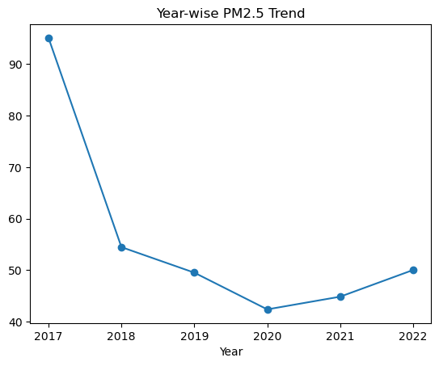
📈 Year-wise PM2.5 Trend Line Plot
Purpose
Shows the average PM2.5 level for each year from 2017 to 2022.
Key Findings
2017 has the highest average PM2.5 level.
PM2.5 levels decreased from 2017 to 2020.
2020 recorded the lowest pollution level.
Pollution increased slightly in 2021 and 2022.
Chart Details
X-Axis: Year
Y-Axis: Average PM2.5

Slide 18
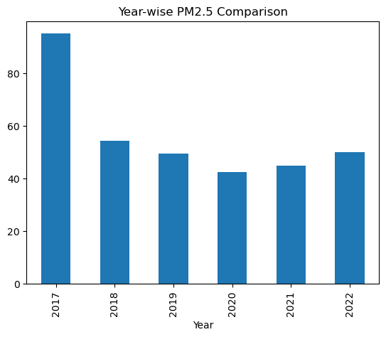
📊 Year-wise PM2.5 Comparison (Bar Chart)
Purpose
Compares the average PM2.5 levels across different years.
Key Findings
2017 has the highest average PM2.5 level.
2020 has the lowest average PM2.5 level.
Pollution levels increased slightly after 2020.
The bar chart makes it easy to compare pollution levels between years.
Chart Details
X-Axis: Year
Y-Axis: Average PM2.5

Slide 19
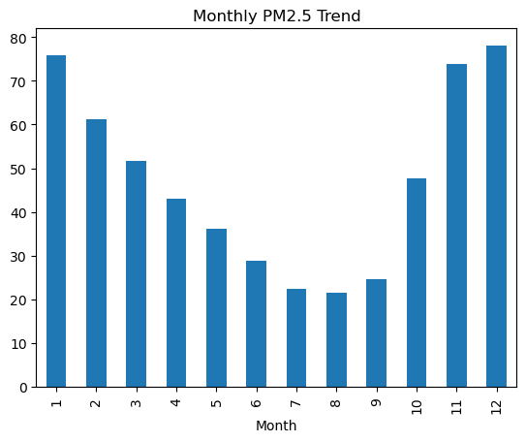
📊 Monthly PM2.5 Trend
Purpose
Shows the average PM2.5 level for each month.
Key Points
PM2.5 is highest in January and December.
PM2.5 is lowest in July and August.
Pollution decreases from January to August.
Pollution increases again from September to December.
Chart Details
X-Axis: Month
Y-Axis: Average PM2.5

Slide 20
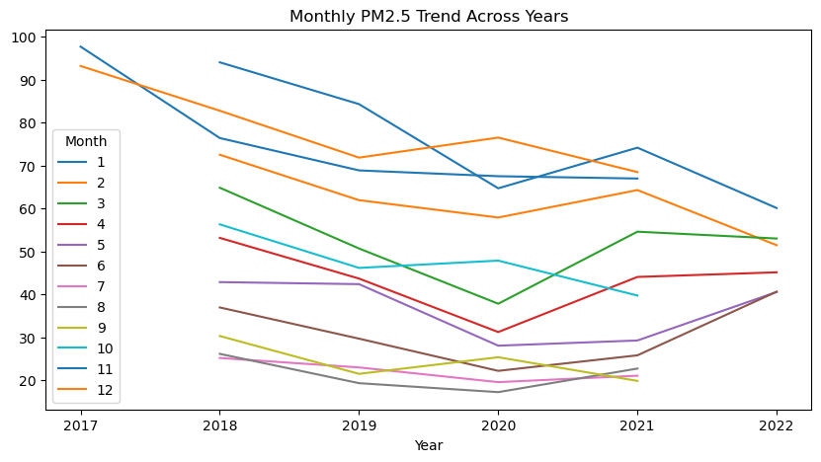
📈 Year vs Month PM2.5 Trend
📈 Year vs Month PM2.5 Trend
Purpose
Shows how the average PM2.5 level changes across different months and years.
Key Points
Compares monthly PM2.5 levels for each year.
Helps identify pollution trends over time.
Shows seasonal changes in air pollution.
Chart Details
X-Axis: Year
Y-Axis: Average PM2.5
Lines: Months (January–December)

Slide 21
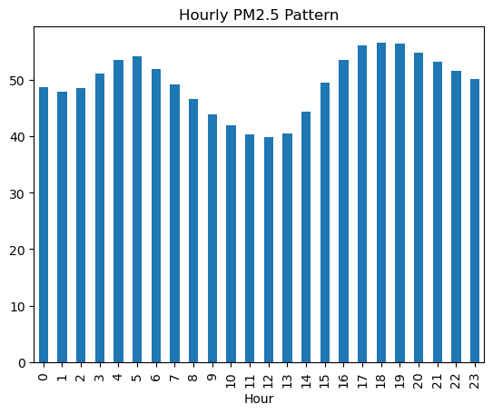
Hour-wise pollution visualization:
Purpose
Shows the average PM2.5 level at different hours of the day.
Key Points
PM2.5 changes throughout the day.
Pollution is higher during evening hours.
Pollution is lower around midday.
Helps identify peak pollution hours.
Chart Details
X-Axis: Hour
Y-Axis: Average PM2.5

Slide 22
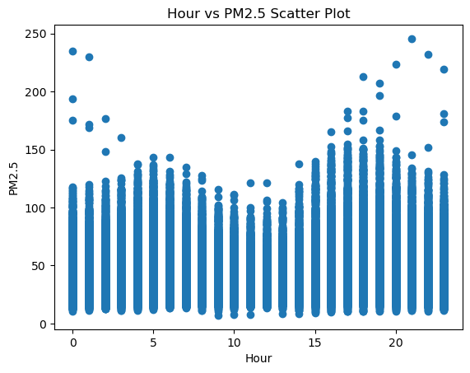
### Scatter plot :
📍 Hour vs PM2.5 Scatter Plot
Purpose
Shows the relationship between hour and PM2.5 levels.
Key Points
PM2.5 levels vary at different hours.
Higher pollution is observed during some evening hours.
Lower pollution is seen around midday.
Helps identify pollution patterns throughout the day.
Chart Details
X-Axis: Hour
Y-Axis: PM2.5

Slide 23
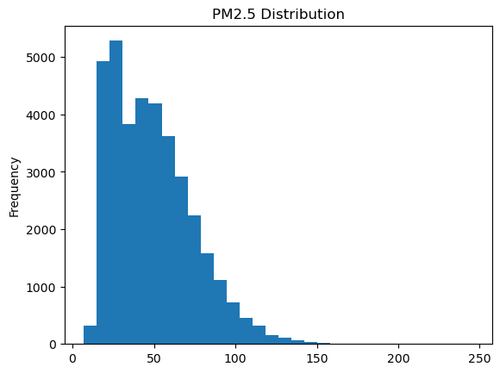
### Distribution of PM2.5:
* Tells pollution spread
📊 Distribution of PM2.5
Purpose
Shows how PM2.5 values are distributed in the dataset.
Key Points
Most PM2.5 values are between 20 and 80.
High PM2.5 values occur less frequently.
Shows the spread of air pollution levels.
Helps understand the overall distribution of PM2.5.
Chart Details
X-Axis: PM2.5
Y-Axis: Frequency

Slide 24
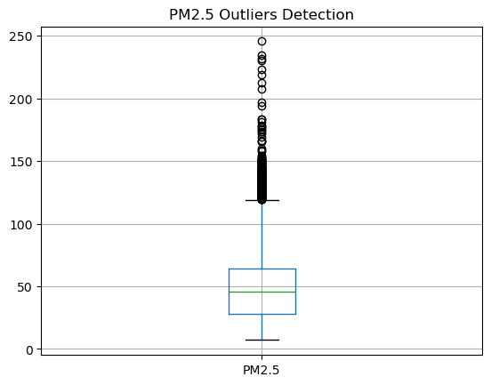
Outlier Detection:
📦 Outlier Detection (Box Plot)
Purpose
Shows unusual or extreme PM2.5 values in the dataset.
Key Points
Identifies outliers in PM2.5 values.
Most PM2.5 values are within the normal range.
A few values are much higher than the rest.
Helps detect unusual pollution levels.
Chart Details
Y-Axis: PM2.5
Dots: Outlier values
Box: Normal range of PM2.5 values

Slide 25
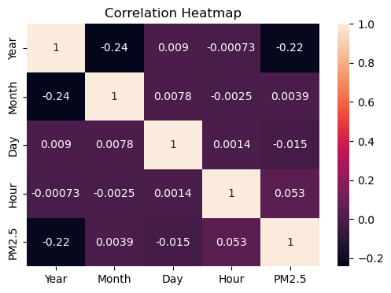
### Heatmap visualization:
*
🔥 Correlation Heatmap
Purpose
Shows the relationship between PM2.5 and other variables using different colors.
Key Points
Displays the correlation between variables.
Helps identify positive and negative relationships.
Darker colors indicate stronger correlation.
Useful for understanding data patterns.
Chart Details
Rows & Columns: Year, Month, Day, Hour, PM2.5
Colors: Show the strength of correlation

Slide 26
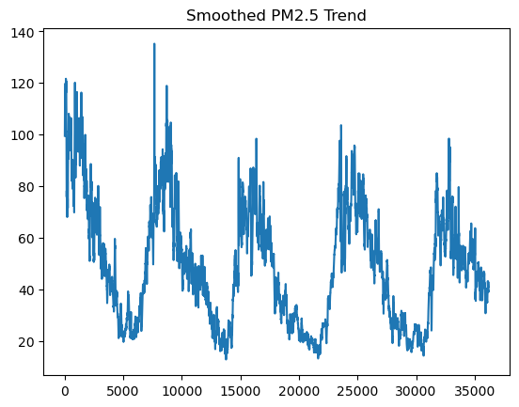
### Trend Smoothing
📈 Trend Smoothing
Purpose
Shows the overall PM2.5 trend by reducing small fluctuations in the data.
Key Points
Removes short-term changes in PM2.5.
Displays the overall pollution trend clearly.
Helps identify long-term patterns.
Makes the data easier to understand.
Chart Details
X-Axis: Data Index / Time
Y-Axis: Smoothed PM2.5

Slide 27
Conclusion
The air quality dataset was successfully analyzed using Python, Pandas, NumPy, Matplotlib, and Seaborn.
Data cleaning and visualization helped identify PM2.5 trends across years, months, and hours.
The analysis showed changes in pollution levels and detected outliers and correlations in the data.
This project demonstrates how data analytics can be used to understand air pollution and support better environmental decisions.

Slide 28
Thank You!

